Slide 1
Performance and Revenue Analysis by Region and Partner for SME
-Prajakta Harihar Zaavde

Slide 2
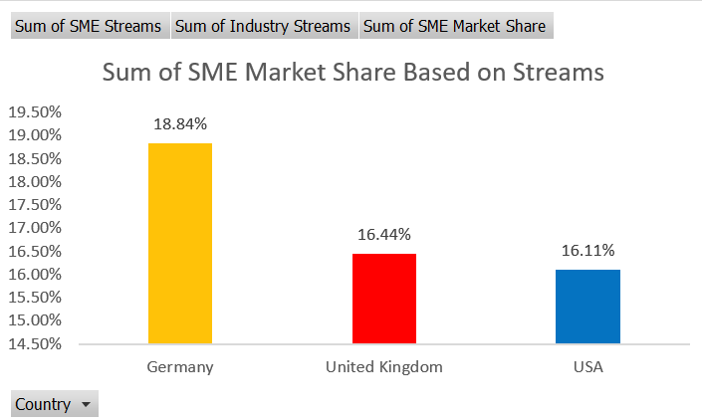
SME Market Share and Performance by Region
Germany:
SME Market Share: 18.84%
Total SME Streams: 13.6B
United Kingdom:
SME Market Share: 16.44%
Total SME Streams: 10.3B
USA:
SME Market Share: 16.11%
Total SME Streams: 68.6B
Key Insights: Higher SME market shares in Germany, with lower percentages in the USA despite having the largest number of streams.

Slide 3
Regional Breakdown of Users and Partner Revenue
Key Regions with High Growth:
India: User growth of 63.64% and partner revenue growth of 82.82%.
Mexico: User growth of 23.28% and partner revenue growth of 24.11%.
South Africa: User growth of 31.08% and revenue growth of 35.43%.
Switzerland has the highest average revenue per paid subscribers of 0.78.
Key Observations: Fastest growth in emerging markets (India, South Africa, Mexico), with slower growth in developed regions like the USA and UK.

Slide 4
Key Performance Indicators (KPIs) for Market Maturity Assessment
KPI 1 - Internet Penetration
Higher penetration allows for better customer behavior analysis and engage.
Current Market Maturity:
Advanced: Australia, Brazil, Chile, France, Germany, Spain, Sweden, Switzerland, UK, USA
Established: Indonesia, Italy, Mexico, South Africa
Developing: India, Philippines
KPI 2 - GDP per Capita
Reflects economic performance and purchasing power, helping assess standard of living and growth potential.
Current Market Maturity:
Initial: < $10,000
Developing: $10,000 - $30,000
Established: $30,000 - $50,000
Advanced: > $50,000
KPI 3 - Consumer Price Index (CPI)
Helps in deciding their pricing decision, and helps organizations in making informed decisions. CPI can impact supplier pricing and logistics costs. A declining CPI could lead to more cautious investment strategies.
Other possible KPIs that can be used are- Average Revenue Per User, Churn Rate etc.

Slide 5
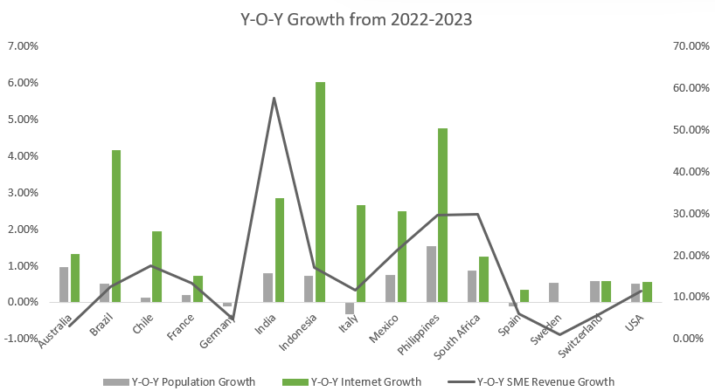
Most Lucrative markets with growth potential
SME Revenue Growth (2022-2023):
India: +57.71%
Mexico: +21.10%
Brazil: +12.60%
Measures direct revenue
expansion and market
potential for future investments.

Slide 6
More Reasons:
2. Population Growth & Internet Penetration:
India: Population +0.81%, Internet Penetration +2.86%.
Mexico: Population +0.75%, Internet Penetration +2.50%.
Brazil: Population +0.52%, Internet Penetration +4.17%.
Indicates the addressable market size and accessibility for digital services like streaming.
3. Free Users Monetization:
Free users are equally valuable as premium ones in these markets, suggesting a focus on ad-supported models and gradual premium conversion.
Captures untapped revenue potential from free-tier users, showing opportunities for further growth.
4. Big Mac Index & Currency Strength:
India’s rising currency value: Big Mac Index adjustments show gradual economic improvement, meaning potential for higher subscription rates and revenue in the future.
Demonstrates purchasing power parity and the potential to raise wholesale rates over time.

Slide 7
Thank You

